Slide 1

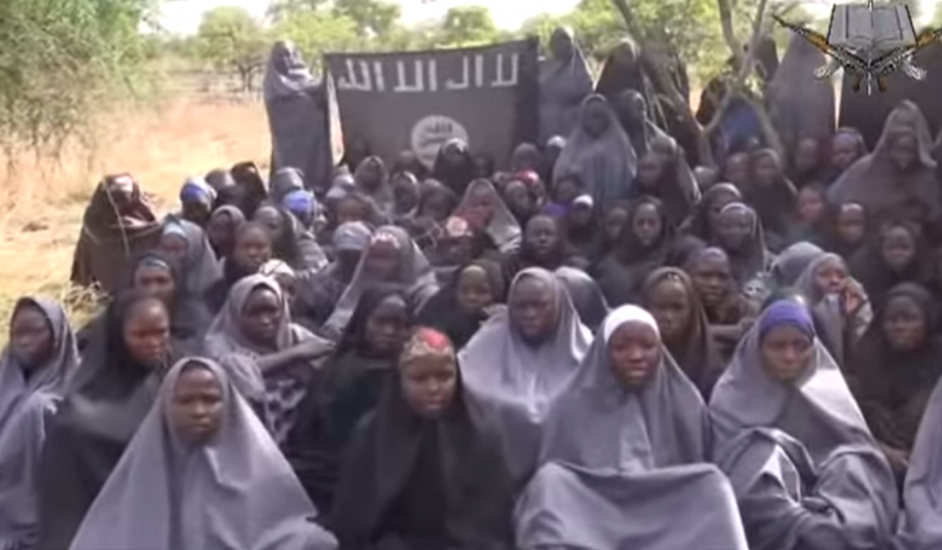
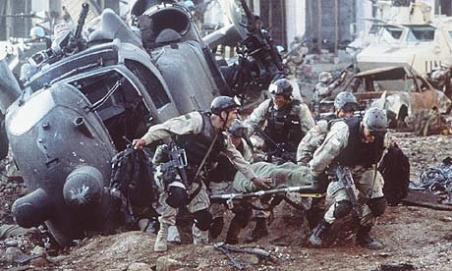
Terrorism in Sub Saharan Africa:
Boko Haram & Al-Shabab
A Presentation by Amb. Mahesh Sachdev
CLAWS Seminar; New Delhi; Feb 25 2016

Slide 2
Terror in SS Africa: General Remarks
Ethnic, Religious and Socio-Political Contexts
Overlapping National, Tribal & Religious Identities
Porous Colonial Borders with Straddled Tribes
Governance: Weak, Ham-handed and Episodic
Political Legitimacy, Inclusiveness and Maturity
North African Connection: AQIM, etc.
Easy Availability of Weapons: Post-Qaddafi Libya
Global Theatre and Global Theatrics
Ambitions, Goals and Reach of African Militants

Slide 3
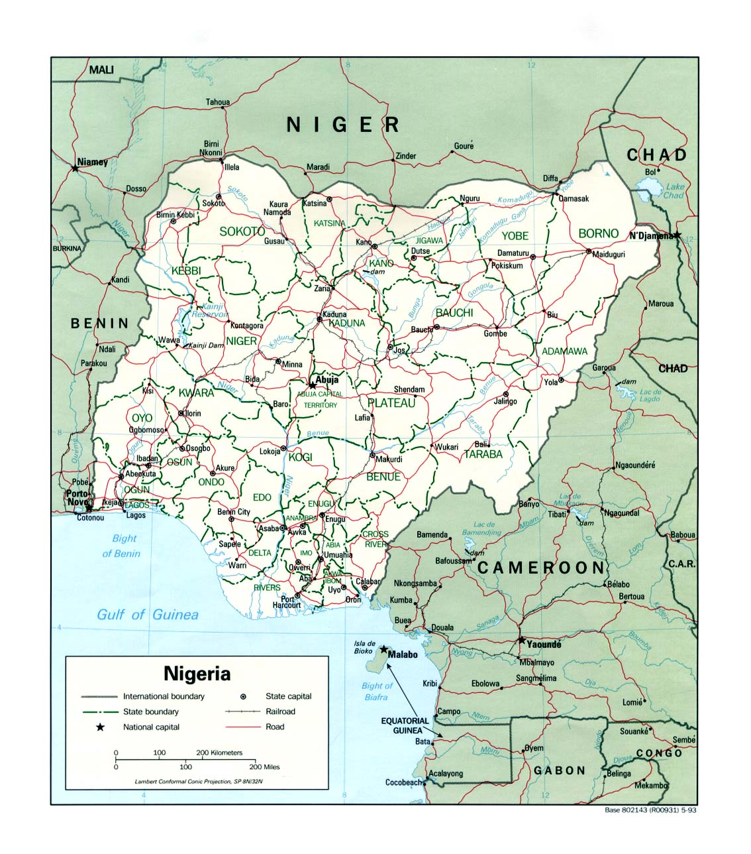
NIGERIA

Slide 4
Boko Haram: 2002-09
The Background of ‘جماعة أهل السنة للدعوة والجهاد’
Geography and History of Bornu Empire
The Issues of Kannuri Ethnicity
The Politics of Elections and Sharia
2009 Clampdown
Regrouping and Ideological Evolution

Slide 5
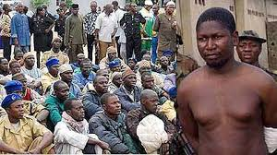
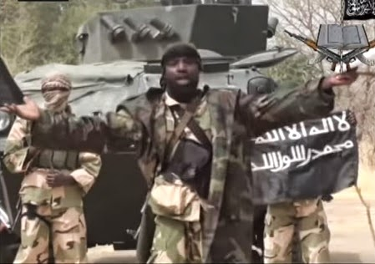
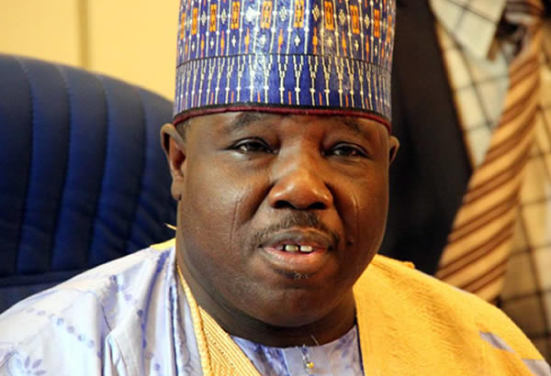
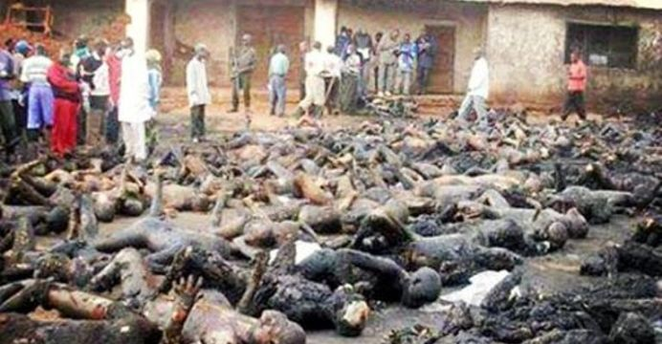
Boko Haram Visuals
Last Picture of Founder Mohammed Yusuf Alive A Screen Shot of Abubakar Shekhau, Current Leader
Ali Modu Shatif , Governor Borno 2003-2011 Boko Haram Carnage at Baga 2014

Slide 6
Boko Haram: 2009 - Onwards
Full Circle: Terror>Insurgency>Terror> ?
The Government Response: 1 2009-16
Military Conundrum: Pride and Performance
Buhari Presidency: More Comprehensive Strategy
Regional and African Responses; MNJTF
International Aspects: الولاية الإسلامية غرب أفريقيا?
Humanitarian Aspects: “#BringBackOur Girls”
End Game: Military Defeat+ Eco-Political Reforms
India’s Concerns: Attack in June 2012, etc.

Slide 7
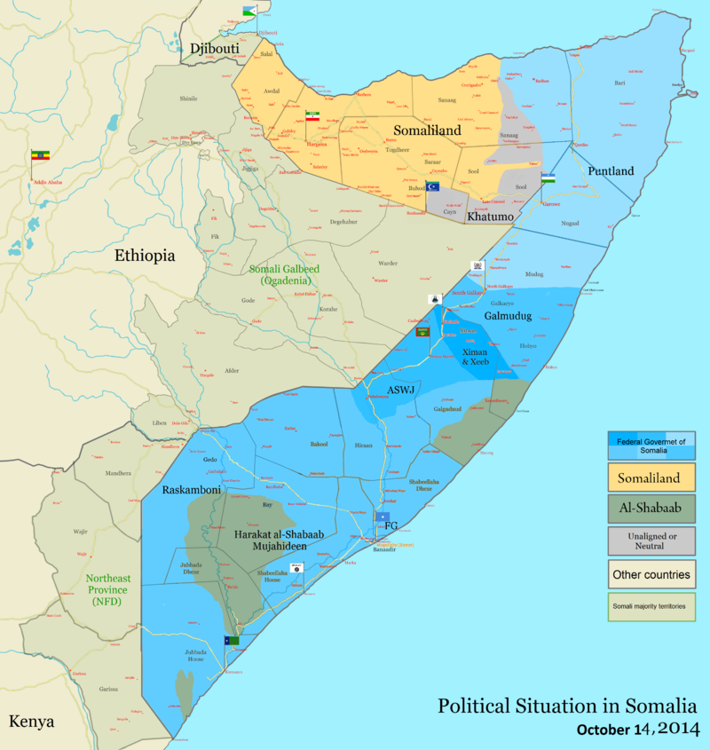


Slide 8
Al Shabab: A Snapshot
Siad Barre’s Rule in Somalia (1969-91)
Subsequent Vacuum Fissiparous Trends and Anarchy
Ethnic and Religious Issues in the Horn Region
Poverty Trap, Drought and Foreign Aid
Islamic Courts Union (ICU)
حركة الشباب المجاهدين Harka Al-Shabab Al-Mujahedin
African Union Mission to Somalia (AMISOM)
Allegiance to Al-Qaeda (2012) & Islamic Terror Links
WestGate Shopping Mall Attack, Nairobi (9/13)
Piracy in Western Indian Ocean

Slide 9
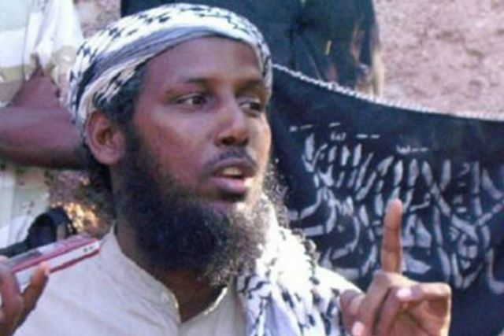
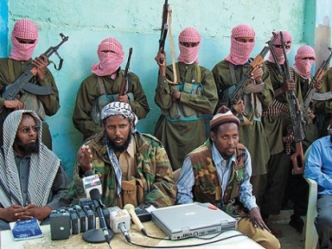
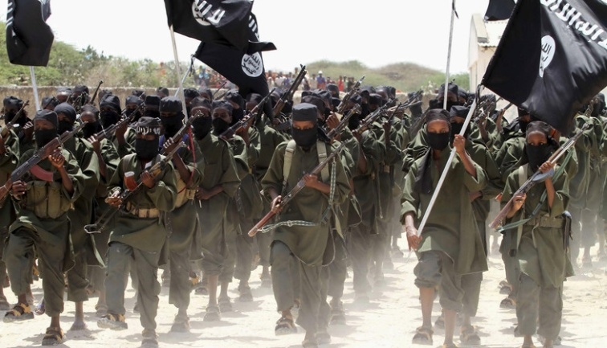
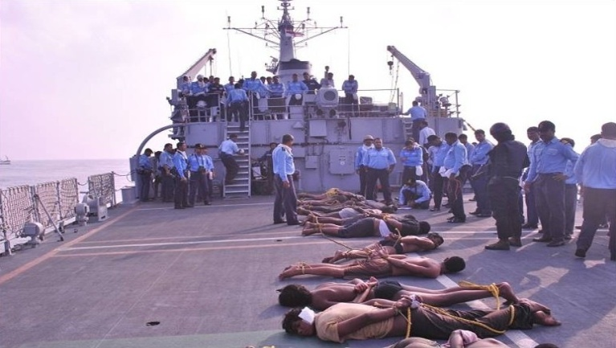
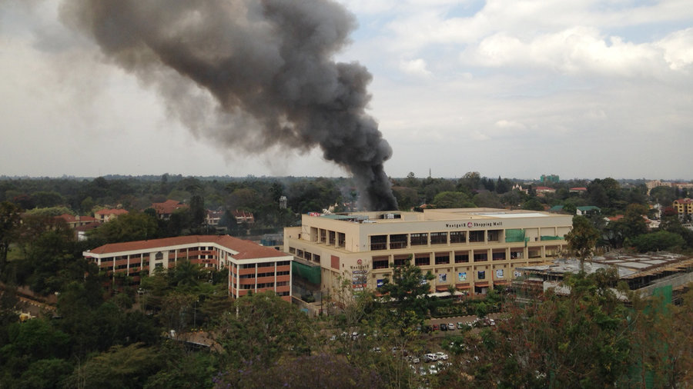
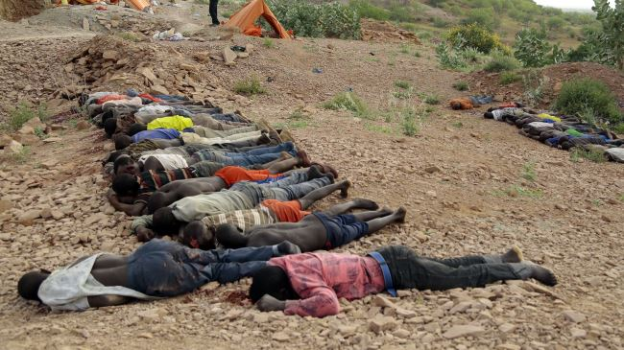
Al Shabab Visuals
Founder Ahmed Godane (12/2007–9/2014) Current Leader Ahmed Umar(Abu Ubaidah)
A Screenshot of Al Shabab Video Captured Somali Pirates on Indian Navy Ship
Westside Mall Nairobi Siege 9/2013 Al-Shabab Masacre in Northern Kenya

Slide 10
Terror in SS Africa: Some Conclusions
Similarities & Differences from Other Regions
Better Grasp Needed of Local Specifics (Ethnic)
Significance of Local Socio-Political Stimuli
Inter-linkages among Stakeholders
With Friend Like These....
Patient Multi-Pronged Approach Required.
Thank You!
for Comments & Questions, reference, etc.:
amb.sachdev@eco-diplomacy.com; www.eco-diplomacy.com

